Slide 1
One to Many MSBA BAN 6020 Data Management
Carolina Salge

Slide 2
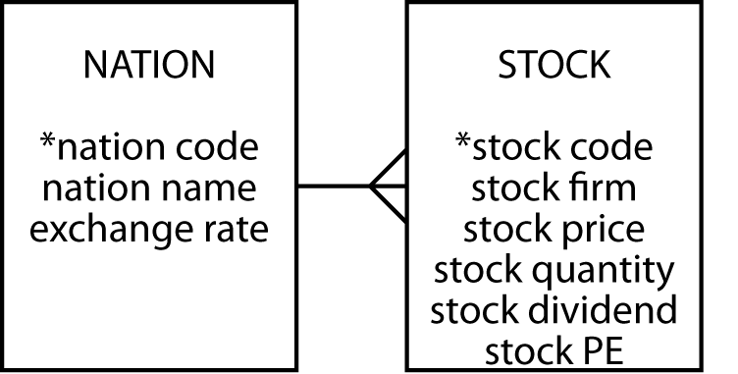
One to Many
Entities are related to other entities
A 1:m relationship

Slide 3
Stock with Additional Columns
stock
stkcode | stkfirm | stkprice | stkqty | stkdiv | stkpe | natname | exchrate
FC | Freedonia Copper | 27.50 | 10529 | 1.84 | 16 | United Kingdom | 1.00
PT | Patagonian Tea | 55.25 | 12635 | 2.50 | 10 | United Kingdom | 1.00
AR | Abyssinian Ruby | 31.82 | 22010 | 1.32 | 13 | United Kingdom | 1.00
SLG | Sri Lankan Gold | 50.37 | 32868 | 2.68 | 16 | United Kingdom | 1.00
ILZ | Indian Lead &Zinc | 37.75 | 6390 | 3.00 | 12 | United Kingdom | 1.00
BE | Burmese Elephant | .07 | 154713 | 0.01 | 3 | United Kingdom | 1.00
BS | Bolivian Sheep | 12.75 | 231678 | 1.78 | 11 | United Kingdom | 1.00
NG | Nigerian Geese | 35.00 | 12323 | 1.68 | 10 | United Kingdom | 1.00
CS | Canadian Sugar | 52.78 | 4716 | 2.50 | 15 | United Kingdom | 1.00
ROF | Royal Ostrich Farms | 33.75 | 1234923 | 3.00 | 6 | United Kingdom | 1.00
MG | Minnesota Gold | 53.87 | 816122 | 1.00 | 25 | USA | 0.67
GP | Georgia Peach | 2.35 | 387333 | .20 | 5 | USA | 0.67
NE | Narembeen Emu | 12.34 | 45619 | 1.00 | 8 | Australia | 0.46
QD | Queensland Diamond | 6.73 | 89251 | .50 | 7 | Australia | 0.46
IR | Indooroopilly Ruby | 15.92 | 56147 | .50 | 20 | Australia | 0.46
BD | Bombay Duck | 25.55 | 167382 | 1.00 | 12 | India | 0.0228
Why create an additional entity?

Slide 4
Insert, Delete, Update
Insert
Buy French stocks to record its exchange rate
Delete
Delete a stock and lose data on exchange rate
Update
If UK rate changes need to update table 10 times

Slide 5
Mapping Database
Each entity becomes a table
The entity name becomes the table name
Each attribute becomes a column
Add a column to table at the many end
Place identifier of the one end in the column

Slide 6
Nation and Stock
nation
natcode | natname | exchrate
UK | United Kingdom | 1.00
USA | United States | 0.67
AUS | Australia | 0.46
IND | India | 0.0228
stock
stkcode | stkfirm | stkprice | stkqty | stkdiv | stkpe | natcode
FC | Freedonia Copper | 27.50 | 10529 | 1.84 | 16 | UK
PT | Patagonian Tea | 55.25 | 12635 | 2.50 | 10 | UK
AR | Abyssinian Ruby | 31.82 | 22010 | 1.32 | 13 | UK
SLG | Sri Lankan Gold | 50.37 | 32868 | 2.68 | 16 | UK
ILZ | Indian Lead &Zinc | 37.75 | 6390 | 3.00 | 12 | UK
BE | Burmese Elephant | .07 | 154713 | 0.01 | 3 | UK
BS | Bolivian Sheep | 12.75 | 231678 | 1.78 | 11 | UK
NG | Nigerian Geese | 35.00 | 12323 | 1.68 | 10 | UK
CS | Canadian Sugar | 52.78 | 4716 | 2.50 | 15 | UK
ROF | Royal Ostrich Farms | 33.75 | 1234923 | 3.00 | 6 | UK
MG | Minnesota Gold | 53.87 | 816122 | 1.00 | 25 | USA
GP | Georgia Peach | 2.35 | 387333 | .20 | 5 | USA
NE | Narembeen Emu | 12.34 | 45619 | 1.00 | 8 | AUS
QD | Queensland Diamond | 6.73 | 89251 | .50 | 7 | AUS
IR | Indooroopilly Ruby | 15.92 | 56147 | .50 | 20 | AUS
BD | Bombay Duck | 25.55 | 167382 | 1.00 | 12 | IND

Slide 7

Foreign Keys
A foreign key (FK) is a column that is a primary key (PK) of another table
natcode in stock is a FK because natcode is the PK of nation
PK
FK

Slide 8
Referential Integrity Constraint
For every FK value there is a PK value
For every value of natcode in stock there is a value of natcode in nation
A PK must exist before a FK can be defined
Must create the nation before its stocks

Slide 9
Define a Table
create table nation (
natcode char(3),
natname varchar(20),
exchrate decimal(9,5),
primary key(natcode));
create table stock (
shrcode char(3),
shrfirm varchar(20) not null,
shrprice decimal(6,2),
shrqty decimal(8),
shrdiv decimal(5,2),
shrpe decimal(2),
primary key(stkcode),
constraint fk_has_nation foreign key(natcode)
references nation(natcode));

Slide 10
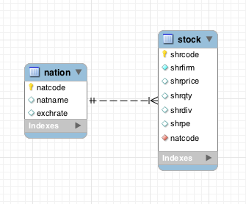
MySQL Workbench

Slide 11
Exercise
Develop a data model to keep track of a athlete’s running performance (e.g., distance and time) over various lengths
Create database and add 3 rows for each athlete

Slide 12
Join
Create a new table from two existing tables
select * from stock, nation
where stock.natcode = nation.natcode;
shrcode | shrfirm | shrprice | shrqty | shrdiv | shrpe | natcode | natcode | natname | exchrate
NE | Narembeen Emu | 12.34 | 45619 | 1.00 | 8 | AUS | AUS | Australia | 0.46000
IR | Indooroopilly Ruby | 15.92 | 56147 | 0.50 | 20 | AUS | AUS | Australia | 0.46000
QD | Queensland Diamond | 6.73 | 89251 | 0.50 | 7 | AUS | AUS | Australia | 0.46000
BD | Bombay Duck | 25.55 | 167382 | 1.00 | 12 | IND | IND | India | 0.02280
ROF | Royal Ostrich Farms | 33.75 | 1234923 | 3.00 | 6 | UK | UK | United Kingdom | 1.00000
CS | Canadian Sugar | 52.78 | 4716 | 2.50 | 15 | UK | UK | United Kingdom | 1.00000
FC | Freedonia Copper | 27.50 | 10529 | 1.84 | 16 | UK | UK | United Kingdom | 1.00000
BS | Bolivian Sheep | 12.75 | 231678 | 1.78 | 11 | UK | UK | United Kingdom | 1.00000
BE | Burmese Elephant | 0.07 | 154713 | 0.01 | 3 | UK | UK | United Kingdom | 1.00000
ILZ | Indian Lead & Zinc | 37.75 | 6390 | 3.00 | 12 | UK | UK | United Kingdom | 1.00000
SLG | Sri Lankan Gold | 50.37 | 32868 | 2.68 | 16 | UK | UK | United Kingdom | 1.00000
AR | Abyssinian Ruby | 31.82 | 22010 | 1.32 | 13 | UK | UK | United Kingdom | 1.00000
PT | Patagonian Tea | 55.25 | 12635 | 2.50 | 10 | UK | UK | United Kingdom | 1.00000
NG | Nigerian Geese | 35.00 | 12323 | 1.68 | 10 | UK | UK | United Kingdom | 1.00000
MG | Minnesota Gold | 53.87 | 816122 | 1.00 | 25 | US | US | United States | 0.67000
GP | Georgia Peach | 2.35 | 387333 | 0.20 | 5 | US | US | United States | 0.67000

Slide 13
Join Template
The new table is created by matching on a common column—natcode
select <COLUMNS> from <TABLE1, TABLE2>
where <TABLE1.PK/FK> = <TABLE2.PK/FK>;

Slide 14
Group By
List the total value of stockholdings by nation
select natname, sum(stkprice*stkqty*exchrate) as stkvalue from stock, nation
where stock.natcode = nation.natcode
group by natname;
natname | stkvalue
Australia | 946430.65
India | 97506.71
United Kingdom | 48908364.25
United States | 30066065.54

Slide 15
Having
The where clause of group by
List the total value of stocks for nations with two or more listed stocks
select natname, sum(stkprice*stkqty*exchrate) as stkvalue from stock, nation
where stock.natcode = nation.natcode
group by natname
having count(*) => 2;
natname | stkvalue
Australia | 946430.65
United Kingdom | 48908364.25
United States | 30066065.54

Slide 16
Exercise
Report the nation name and total stock price for each country that has three or more stocks in the portfolio

Slide 17
Note to Carolina
Stop here! Finish chapter 4 next class

Slide 18
Regular Expression
Search strings without certain characters
[^a-f] means any character not in the set containing a, b, c, d, e, or f
List the names of nations with non-alphabetic characters in their names
select * from nation
where natname regexp '[^a-z|A-Z]';

Slide 19
Regular Expression
Search for string repetition
{n} means repeat the pattern n times
List the name of firms with a double ‘e’
select * from stock where shrfirm regexp '[e]{2}';

Slide 20
Regular Expression
Search strings with many different strings
| means alternation (or)
List the names of firms with a double ‘s’ or a double ‘n’
select * from stock where shrfirm regexp '[s]{2}|[e]{2}';

Slide 21
Regular Expression
Search for multiple versions of a string
[ea] means any character from the set with 'e' or 'a'—it will match for 'e' or 'a'
List the names of firms with names that include ‘inia’ or ‘onia’
select * from stock where shrfirm regexp '[io]nia';

Slide 22
Regular Expression
Find firms with ‘t’ as the third name letter
Find firms not containing ‘s’ in their name
select shrfirm from share
where shrfirm not regexp '^(.){2}t’;
# (.){2} specifies that anything is acceptable for the next two characters. t indicates what the next character, the third, must be
select shrfirm from share
where shrfirm not regexp 's|S';

Slide 23
Exercises
Report the names of nations ending with ‘States’

Slide 24
Subqueries
A query within a query
Report the names of all Australian stocks
select shrfirm from stock where natcode in
(select natcode from nation
where natname = 'Australia');
shrfirm
Narembeen Emu
Queensland Diamond
Indooroopilly Ruby

Slide 25
Subqueries
select shrfirm from stock where natcode in
(select natcode from nation
where natname = 'Australia');
share |  |  |  |  |  |  | nation
shrcode | shrfirm | shrprice | shrqty | shrdiv | shrpe | natcode | natcode | natname | exchrate
NE | Narembeen Emu | 12.34 | 45619 | 1.00 | 8 | AUS | AUS | Australia | 0.46000
IR | Indooroopilly Ruby | 15.92 | 56147 | 0.50 | 20 | AUS | AUS | Australia | 0.46000
QD | Queensland Diamond | 6.73 | 89251 | 0.50 | 7 | AUS | AUS | Australia | 0.46000
BD | Bombay Duck | 25.55 | 167382 | 1.00 | 12 | IND | IND | India | 0.02280
ROF | Royal Ostrich Farms | 33.75 | 1234923 | 3.00 | 6 | UK | UK | United Kingdom | 1.00000
CS | Canadian Sugar | 52.78 | 4716 | 2.50 | 15 | UK | UK | United Kingdom | 1.00000
FC | Freedonia Copper | 27.50 | 10529 | 1.84 | 16 | UK | UK | United Kingdom | 1.00000
BS | Bolivian Sheep | 12.75 | 231678 | 1.78 | 11 | UK | UK | United Kingdom | 1.00000
BE | Burmese Elephant | 0.07 | 154713 | 0.01 | 3 | UK | UK | United Kingdom | 1.00000
ILZ | Indian Lead & Zinc | 37.75 | 6390 | 3.00 | 12 | UK | UK | United Kingdom | 1.00000
SLG | Sri Lankan Gold | 50.37 | 32868 | 2.68 | 16 | UK | UK | United Kingdom | 1.00000
AR | Abyssinian Ruby | 31.82 | 22010 | 1.32 | 13 | UK | UK | United Kingdom | 1.00000
PT | Patagonian Tea | 55.25 | 12635 | 2.50 | 10 | UK | UK | United Kingdom | 1.00000
NG | Nigerian Geese | 35.00 | 12323 | 1.68 | 10 | UK | UK | United Kingdom | 1.00000
MG | Minnesota Gold | 53.87 | 816122 | 1.00 | 25 | US | US | United States | 0.67000
GP | Georgia Peach | 2.35 | 387333 | 0.20 | 5 | US | US | United States | 0.67000

Slide 26
Correlated Subqueries
Solves the inner query many times
Find stocks where their quantity is greater than the average quantity for their country
select natname, shrfirm, stkqty from stock, nation
where stock.natcode = nation.natcode and stkqty >
(select avg(stkqty) from stock
where stock.natcode = nation.natcode);
natname | stkfirm | stkqty
Australia | Queensland Diamond | 89251
United Kingdom | Bolivian Sheep | 231678
United Kingdom | Royal Ostrich Farms | 1234923
United States | Minnesota Gold | 816122

Slide 27
Correlated Subquery
nation
natcode | natname | exchrate
UK | United Kingdom | 1.00
USA | United States | 0.67
AUS | Australia | 0.46
IND | India | 0.0228
select natname, shrfirm, stkqty from stock, nation
where stock.natcode = nation.natcode and stkqty >
(select avg(stkqty) from stock
where stock.natcode = nation.natcode);
stock
stkcode | stkfirm | stkprice | stkqty | stkdiv | stkpe | natcode
FC | Freedonia Copper | 27.50 | 10529 | 1.84 | 16 | UK
PT | Patagonian Tea | 55.25 | 12635 | 2.50 | 10 | UK
AR | Abyssinian Ruby | 31.82 | 22010 | 1.32 | 13 | UK
SLG | Sri Lankan Gold | 50.37 | 32868 | 2.68 | 16 | UK
ILZ | Indian Lead &Zinc | 37.75 | 6390 | 3.00 | 12 | UK
BE | Burmese Elephant | .07 | 154713 | 0.01 | 3 | UK
BS | Bolivian Sheep | 12.75 | 231678 | 1.78 | 11 | UK
NG | Nigerian Geese | 35.00 | 12323 | 1.68 | 10 | UK
CS | Canadian Sugar | 52.78 | 4716 | 2.50 | 15 | UK
ROF | Royal Ostrich Farms | 33.75 | 1234923 | 3.00 | 6 | UK
MG | Minnesota Gold | 53.87 | 816122 | 1.00 | 25 | USA
GP | Georgia Peach | 2.35 | 387333 | .20 | 5 | USA
NE | Narembeen Emu | 12.34 | 45619 | 1.00 | 8 | AUS
QD | Queensland Diamond | 6.73 | 89251 | .50 | 7 | AUS
IR | Indooroopilly Ruby | 15.92 | 56147 | .50 | 20 | AUS
BD | Bombay Duck | 25.55 | 167382 | 1.00 | 12 | IND

Slide 28
Exercise
Report the country, firm, and stock quantity for the maximum quantity of stock held for each country

Slide 29
Recap
Introduced
One to Many Relationship
Foreign Key
group by
having
Correlated Subquery

Slide 30
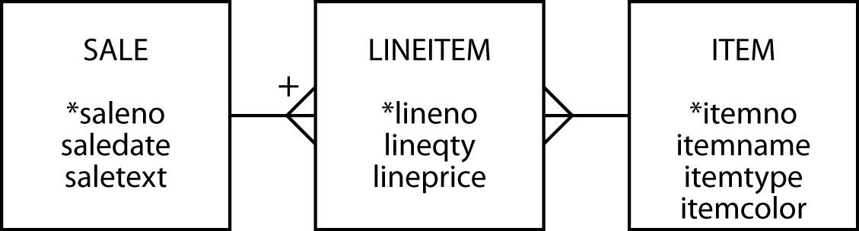
Next Class
Many-To-Many Relationships (5)

